Slide 1
Review of the MiSTer Gamming Console
Jim Brakefield
IEEE San Antonio Computer chapter
19 Feb. 2020
https://events.vtools.ieee.org/m/220917

Slide 2
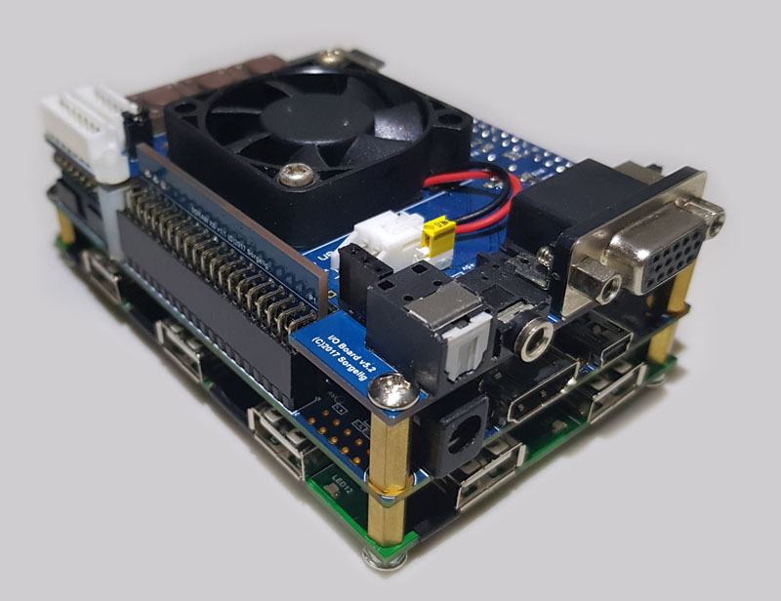
IO card, FPGA card & USB hub
http://emulation.gametechwiki.com/index.php/MiSTer
https://github.com/MiSTer-devel/Main_MiSTer/wiki
RAM card tucked next to IO card

Slide 3
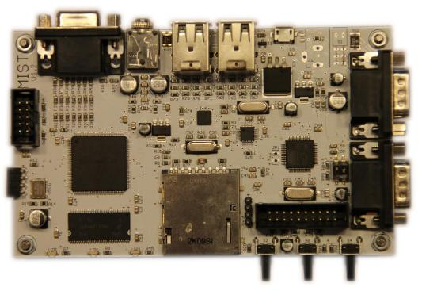
MIST project https://github.com/mist-devel/mist-board/wiki

Slide 4
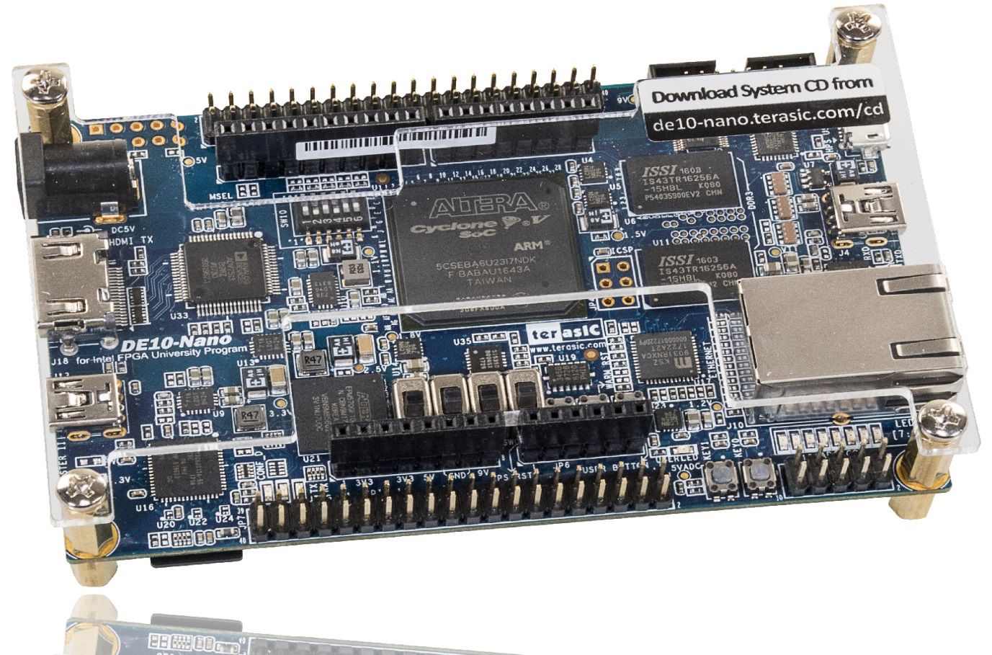
MiSTer FPGA card https://www.terasic.com.tw/cgi-bin/page/archive.pl?Language=English&CategoryNo=167&No=1046

Slide 5
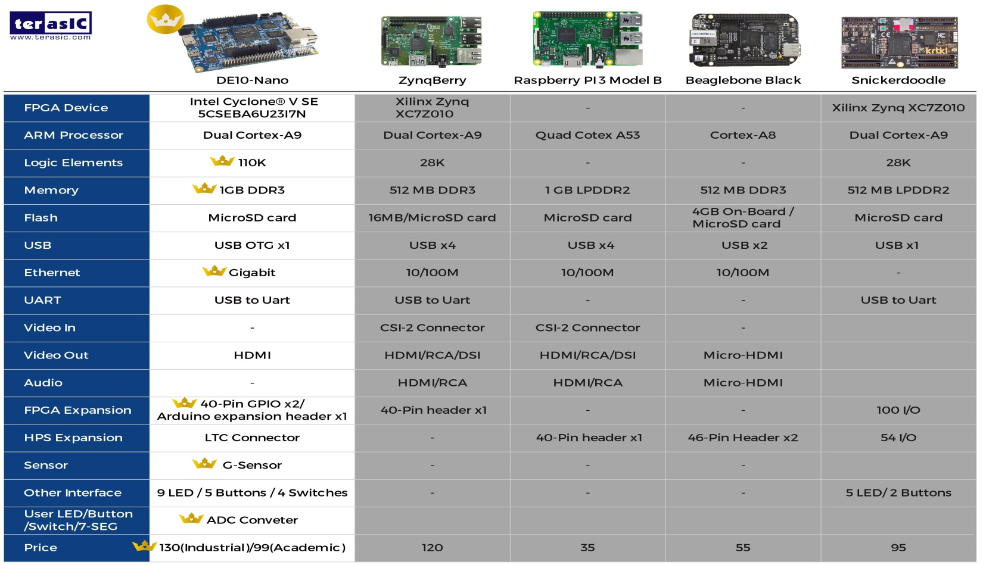
Similar FPGA cards

Slide 6
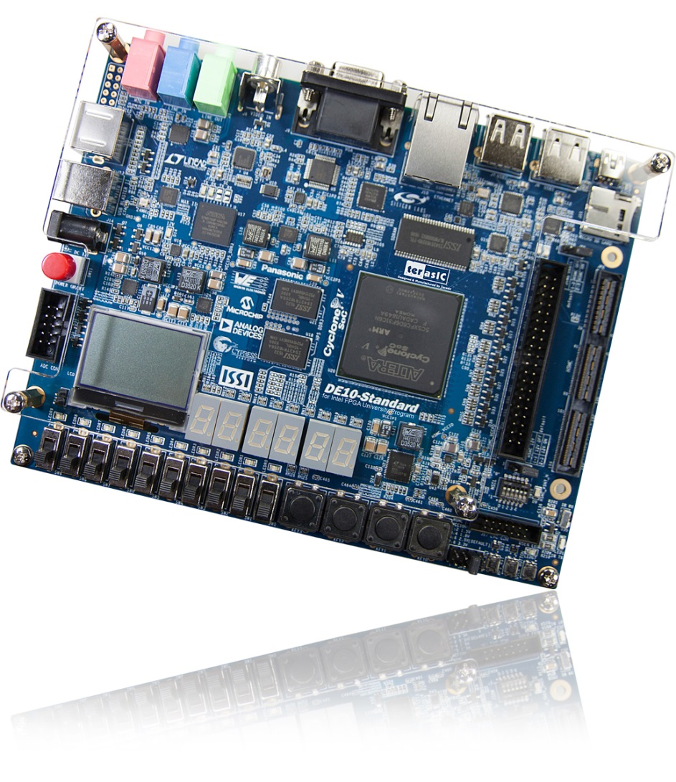
Raffle FPGA card (DE10-Standard)
http://modernhackers.com/porting-mister-to-arrow-sockit-fpga/

Slide 7
MiSTer mantra: exact replica
MiSTer is an open project that aims to recreate various classic computers, game consoles and arcade machines, using modern hardware. It allows software and game images to run as they would on original hardware, using peripherals such as mice, keyboards, joysticks and other game controllers.

Slide 8
Open Source
Bare add-on cards with CAD files
IO card: RGB, Audio, Fan
Memory card: 128MB SDR RAM: https://misterfpga.co.uk/ required by some games (recommended)
USB port expander
FPGA projects (142 of them)
Altera/Intel Quartus (lite/free version)
Complete Quartus projects: *.qpf files
Use open source microprocessor cores (Z80, 6502, …)

Slide 9
Alternatives
Gaming console & cartridge
Legacy: Nintendo, etc.
Modern: Playstation, etc.
PC with fast graphics
Open source game software:
https://en.wikipedia.org/wiki/List_of_open-source_video_games
PC
Raspberry Pi

Slide 10
Available MiSTer “games”
Consoles: http://emulation.gametechwiki.com/index.php/MiSTer
Arcade games: https://github.com/MiSTer-devel/Main_MiSTer/wiki/Arcade-Cores-List
DIY: Register & download Quartus Lite
Select the most similar project & modify

Slide 11
MiSTer FPGA card
Cyclone V FPGA chip with:
Two ARM Cortex A9 at 800 MHz
110K “logic cells”
502KB of block RAM (e.g. > 64KB of 8-bit uP)
112 hardware multipliers
Two pair of 20-pin IO
Arduino IOs
1GB DDR3
HDMI video out
Linear Technology A2D & D2A add-on card

Slide 12
DE10-nano SD card
Runs on FPGA ARM Cortex A9 core
Linux environment
FPGA fabric independent from ARM cores
Works with Quartus

Slide 13
Intel/Altera Quartus https://www.intel.com/content/www/us/en/software/programmable/quartus-prime/overview.html
Software for utilizing Intel/Altera FPGAs
Supports: Verilog, VHDL & System-Verilog RTL (Register Transfer Languages)
Editor, compiler, place & route and bit file generation
Free IP (Intellectual Property) such as memory, DSP, FFT, serial ports, etc. (see also https://opencores.org/)
Have training videos, trade shows & seminars

Slide 14
MiSTer SD card
https://github.com/MiSTer-devel/Main_MiSTer/wiki/Folders-and-File-naming
Linux environment
Root directory holds FPGA .rbf files
Other directories hold game cartridge ROM files
Keyboard F12 used to escape current game
Update script refreshes all games/consoles/uP

Slide 15
MiSTer impressions
Well documented
Well organized and consistent
Many YouTube videos
SmokeMonster commentary on arcade cores
Has list of games running on bare FPGA board

Slide 16
SDRAM requirements
https://github.com/MiSTer-devel/Main_MiSTer/wiki/SDRAM-Requirement-by-cores
https://www.retrorgb.com/mister-cores-without-add-on-boards.html

